Slide 1
IMPACT END TERM
-ADHARSH S

Slide 2


PROJECT ALLOTMENT PORTAL
OBJECTIVE :
Allocate Streams and Project for the Employees.
People involved in accessing the application – HR and COE's.

Slide 3

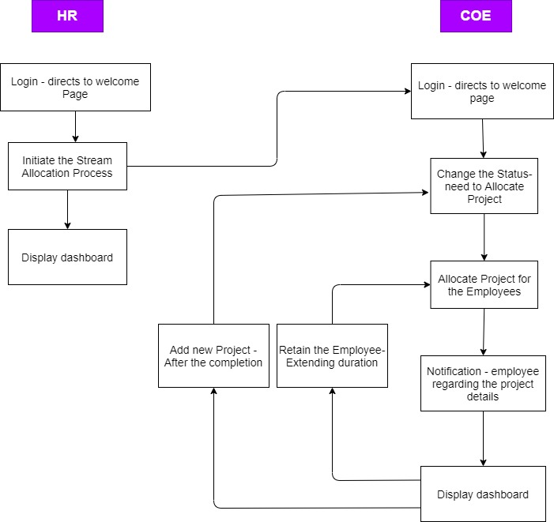



PROCESS FLOW

Slide 4
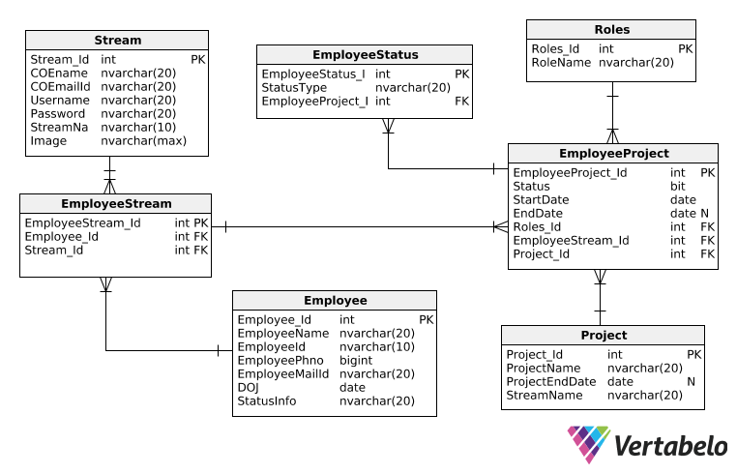
DATA MODEL
BUISNESS CASE :
Login
Stream Allocation
Project Allocation
Update Employee Status
Retain Employee in the Project
Add new project to the Employee

Slide 5
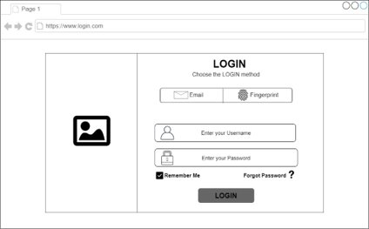
WIREFRAME
LAYOUTS :
Login
Stream Allocation
Project Allocation
Dashboard

Slide 6
Full Stack Application
CLIENT LAYER | BUISNESS LAYER | DATA ACCESS LAYER | DATA LAYER
ANGULAR | WEB API | ENTITY FRAMEWORK | DATA MODEL
SESSION TOKEN | C#,LINQ |  | TEST, PRODUCTION DATA
STORAGE, SECURITY
LOGS
SECURITY
QA

Slide 7





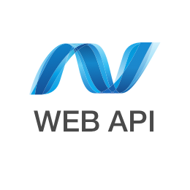




LAYERS
D
A
T
A
F
L
O
W
CLIENT
BUSINESS
DATA
ACCESS
DATABASE

Slide 8



ADDITIONAL FEATURE
CHARTS
NOTIFICATIONS
THEME

Slide 9
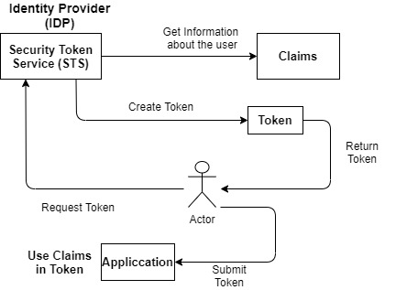
TOKEN

Slide 10
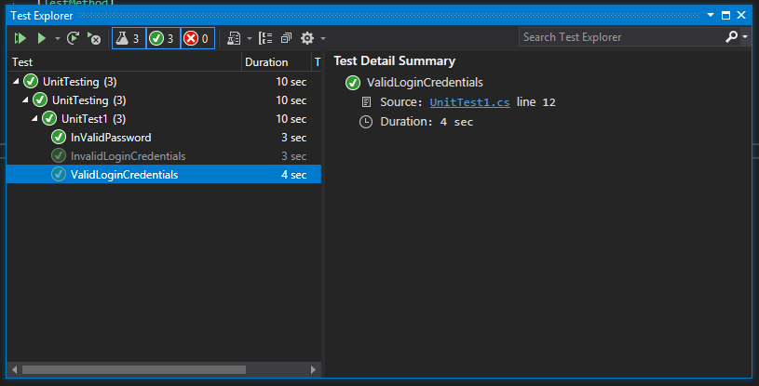
TESTING

Slide 11
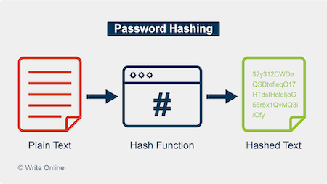
SECURITY

Slide 12


